Slide 1
EMERGENCY
MOBILE/DESKTOP APPLICATION
An idea presentation by Ojoma Anyebe

Slide 2
HACKATHON DESCRIPTION
Critically review the relationship between digital technologies and sustainable economic growth.
The relationship between digital technologies, precisely, an emergency application and sustainable economic growth can be analyzed from multiple perspectives while considering the potential benefits the use of such applications have in promoting economic sustainability.
BENEFITS:
Enhanced Safety and Security: Emergency applications contribute to enhanced safety and security by providing individuals and communities with immediate access to emergency services, information, and resources during critical situations. By mitigating risks associated with emergencies such as medical incidents, natural disasters, or security threats, these applications help safeguard lives and assets, which is foundational for sustainable economic development.

Slide 3
Resilience and Business Continuity: Businesses and industries play a crucial role in driving economic growth. Emergency applications can support business resilience and continuity by enabling timely response and recovery measures in the face of disruptions caused by emergencies. By minimizing downtime, reducing losses, and facilitating rapid recovery, these applications contribute to maintaining economic stability and continuity in the face of unforeseen events.
Efficient Resource Allocation: Effective emergency response facilitated by these applications helps optimize resource allocation by directing emergency services and support to where they are most needed. By enabling efficient use of resources, emergency applications contribute to cost savings, operational efficiency, and improved productivity, which are essential for sustainable economic growth.

Slide 4
Community Well-being and Productivity: Timely response and assistance during emergencies contribute to maintaining community well-being and productivity. By ensuring the health, safety, and welfare of individuals and communities, emergency applications support workforce productivity, social cohesion, and overall quality of life, which are foundational for sustainable economic development.

Slide 5
Selling your idea
APP DESCRIPTION
The Emergency app is a Mobile/Desktop application that is accessible by everyone on the planet. It will serve as a swift medium to get in touch with the respective emergency response agency to report cases of natural disasters or any situation that poses as a threat to human life.
The application will be in form of a conventional social media app that will be used effectively according to a set of rules and regulations that governs it.

Slide 6
TYPES OF EMERGENCIES AND APPROPRIATE RESPONSE AGENCIES
Medical Emergencies:
Appropriate Response Agency: Emergency Medical Services (EMS), also known as paramedics or ambulance services.
Fire Emergencies:
Appropriate Response Agency: Fire Department or Fire Rescue Services.
Terrorist or Security Threats:
Appropriate Response Agencies: Law Enforcement Agencies (local police, FBI, etc.), Homeland Security, and sometimes specialized anti-terrorism units.
Environmental Emergencies (e.g., hazardous materials spills):
Appropriate Response Agencies: Local Fire Department, Environmental Protection Agency (EPA), and sometimes specialized hazardous materials response teams.

Slide 7
Natural Disasters:
Appropriate Response Agencies: Local Emergency Management Agencies, National Weather Service, and sometimes specialized disaster response teams.
Law Enforcement Emergencies:
Appropriate Response Agency: Police Department or Law Enforcement Agencies.
Search and Rescue Operations:
Appropriate Response Agencies: Local Search and Rescue (SAR) teams, National Park Service SAR teams, and sometimes specialized SAR units.

Slide 8
APP FEATURES
Language Preference:
The application will be customizable for respective user’s language preference. It will accommodate major indigenous languages across the globe.
Region Specific:
As users sign up to use the app, they will be required to select their continent, country, and specific region and home/office address . This information will be kept private according to privacy policy requirement and it will be used to efficiently harness the purpose of the application. Also users location will be shared live with response agencies

Slide 9
Contact information of various emergency response systems:
The application will collect the contact information of every emergency response agency available today.
The application will get this information when various emergency response agencies sign in to the application. This is necessary to allow seamless communication between the reporter and the agency.
Video Record, Voice Record, Camera, Image Upload, Call And Text Features:
These features will be made available to help users report emergency cases as explicitly as possible.

Slide 10
OTHER FEATURES:
Personal Safety Features: The user can activate safety features such as a panic button or timer that automatically alerts contacts and authorities especially when the user is in distress or unable to respond.
Medical Profile: The app store essential medical information such as allergies, medications, and emergency contacts within the app, ensuring that first responders have access to critical details during medical emergencies.
Disaster Alerts and Updates: Users will receive real-time alerts and updates about potential disasters, severe weather conditions, or other emergencies in their area, allowing them to take necessary precautions and stay safe.
Community Support: Users can connect with other users in a global community to share information, support each other during emergencies, and coordinate response efforts in times of crisis.

Slide 11
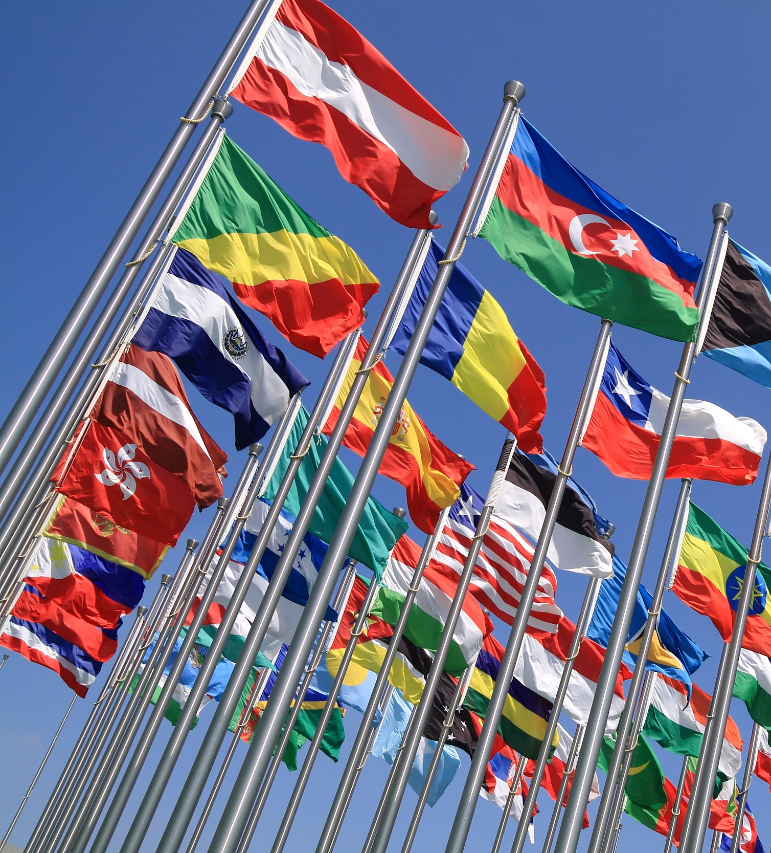
Government Involvement:
All the governing bodies around the world will have access to information regarding cases reported in their respective nations.

Slide 12
STEPS ON HOW CASES ARE REPORTED AND ATTENDED TO:
CASE REPORT.
The user clicks on the appropriate category of report and goes ahead to use the feature available (Video Record, Voice Record, Camera, Image Upload, call or Text) to explain the situation.
The user then goes ahead to click on the send button and waits for a response.

Slide 13

2. Transfer of information (Calls):
For users who decide to make use of the call feature, the call will be placed to the nearest response agency close to the user’s location. And the user will be attended to immediately.

Slide 14
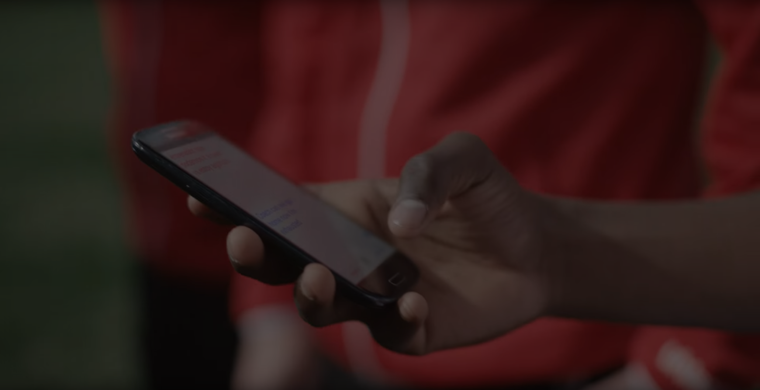
3. OTHER MEDIA OF INFORMATION TRANSFER:
The text, picture, video record or voice record will be sent to multiple concerned response agencies. Starting from the response agency close to the users location to the central response agency available in the country. This is to ensure that the case is attended to as quick as possible.
Once an agency has indicated response and swung into action, other agencies will be notified and restricted from responding but will be on standby incase backup is needed.

Slide 15
PENALTIES:
Local response teams with over 3 hours of delayed response should be penalized by the government
Individuals that deliberately report false cases should also be penalized

Slide 16
PLEASE NOTE:
I do not have any prototype to demonstrate my idea yet.
I am currently putting in effort to learn Mobile application development. Once i learn the basics, i will implement all i have learnt into this project.

Slide 17
THANK YOU SO MUCH UNITAR AND IBM FOR THIS OPPORTUNITY TO LEARN AND GAIN RELEVANT INDUSTRY SKILL SET

